Slide 1
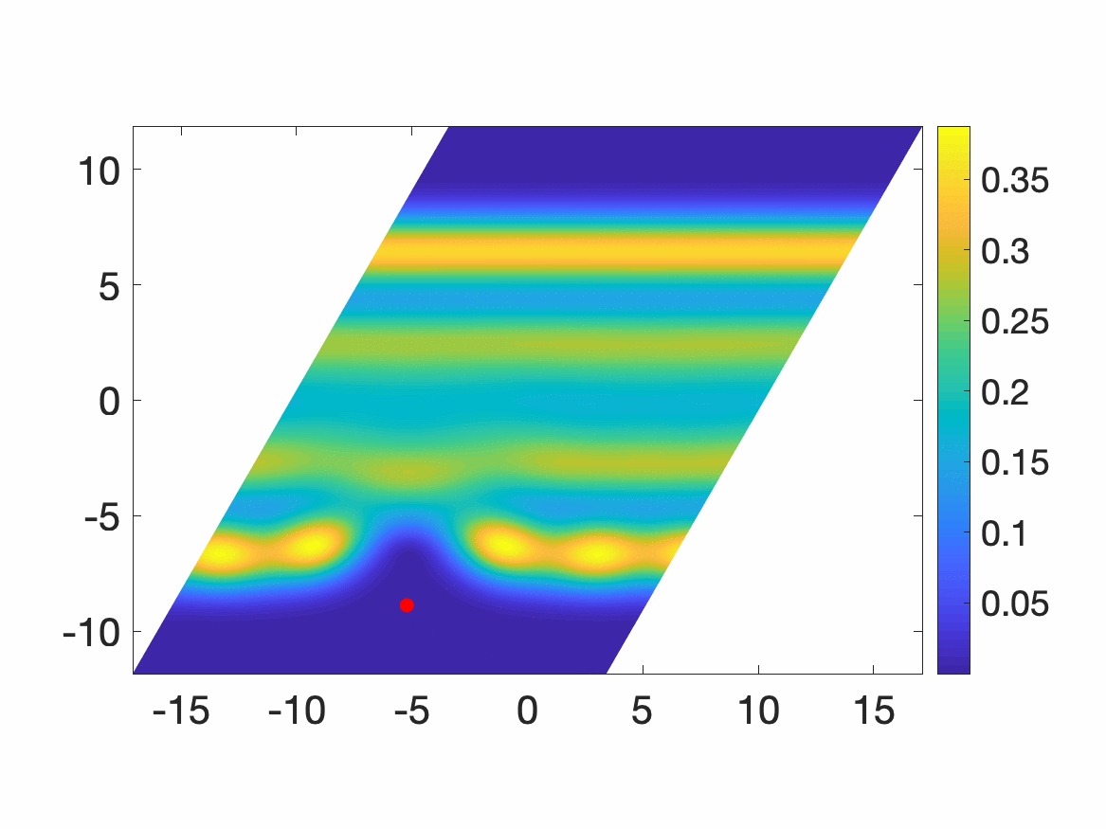
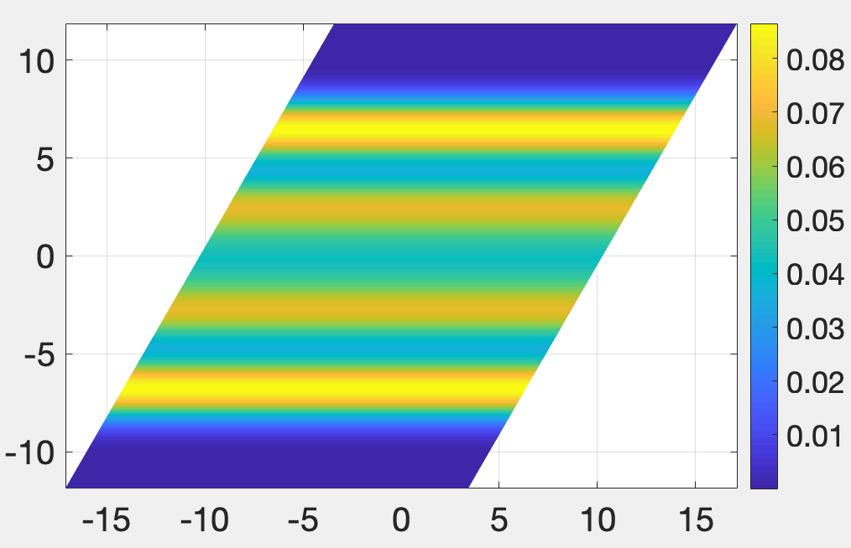
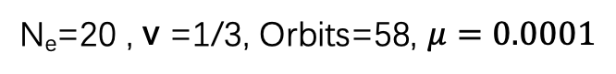
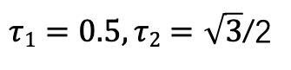
N_{e}=20 , v =1/3, Orbits=58, $μ=0.0001$
parallelogram
Pair correlation function
$τ1=0.5,τ2=\sqrt{3}$/2
Electron density

Slide 2
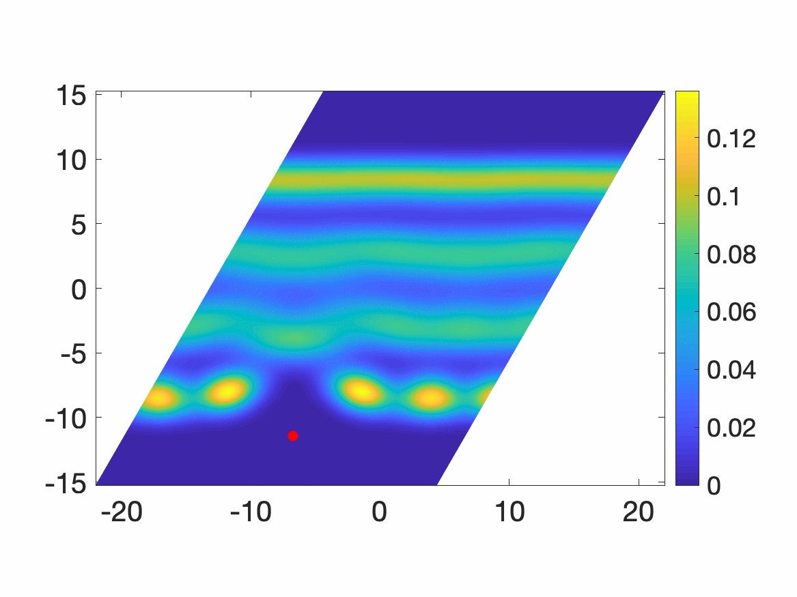
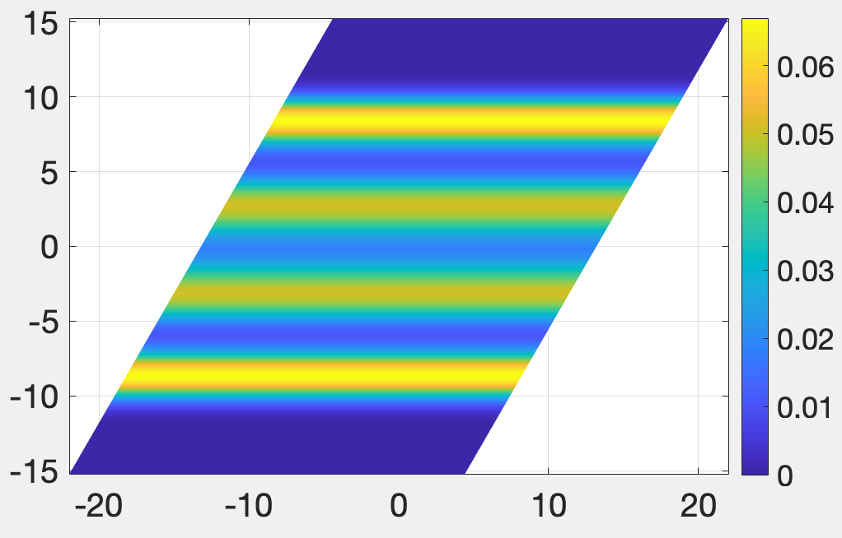
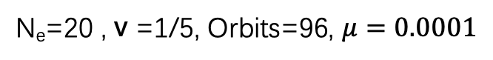
N_{e}=20 , v =1/5, Orbits=96, $μ=0.0001$
parallelogram
Pair correlation function
Electron density

Slide 3
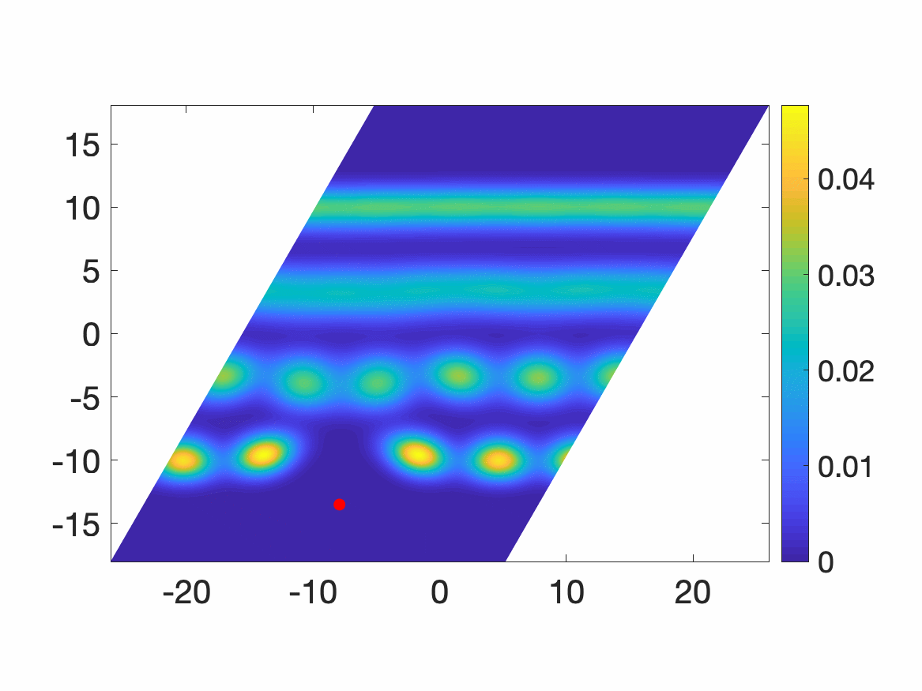
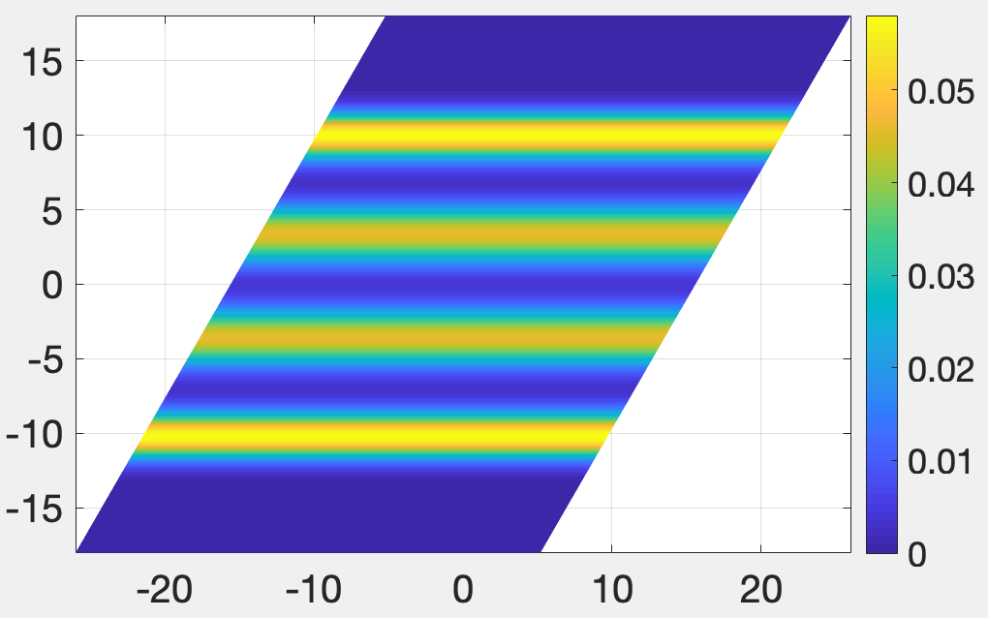
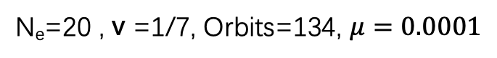
N_{e}=20 , v =1/7, Orbits=134, $μ=0.0001$
parallelogram
Pair correlation function
Electron density

Slide 4
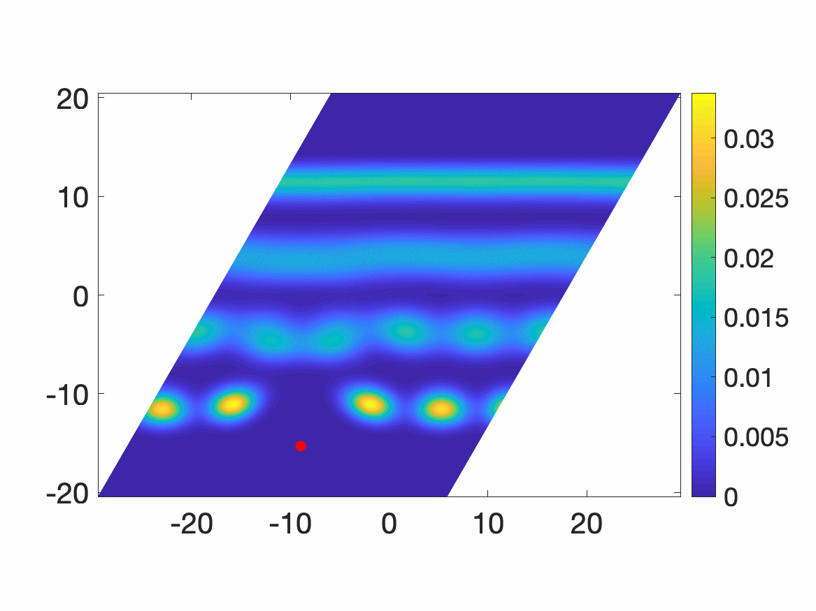
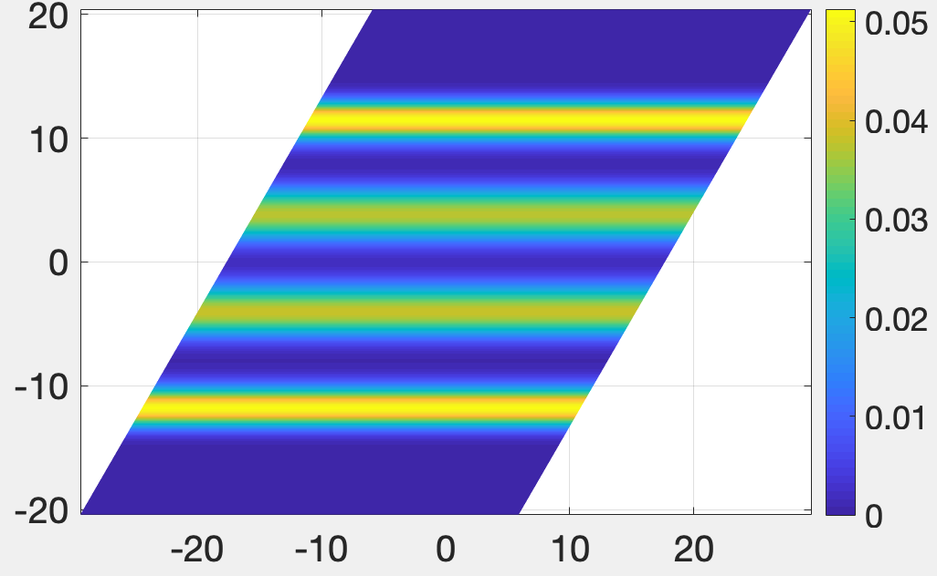
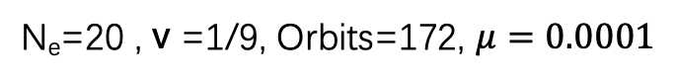
N_{e}=20 , v =1/9, Orbits=172, $μ=0.0001$
parallelogram
Pair correlation function
Electron density

